Slide 1
Curating Log files
Gopalika Sharma Paarth Kotak
Prachi Ved Rashi Chauhan

Slide 2
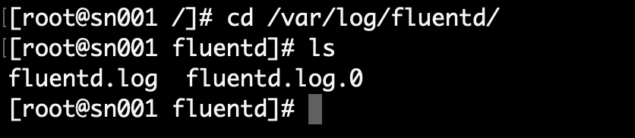
Sprint 1 - recap
Identified log file sources and their location.
2. Understanding Architecture(OpenShift,OpenStack)
3. Spike - ElasticSearch, Kibana

Slide 3
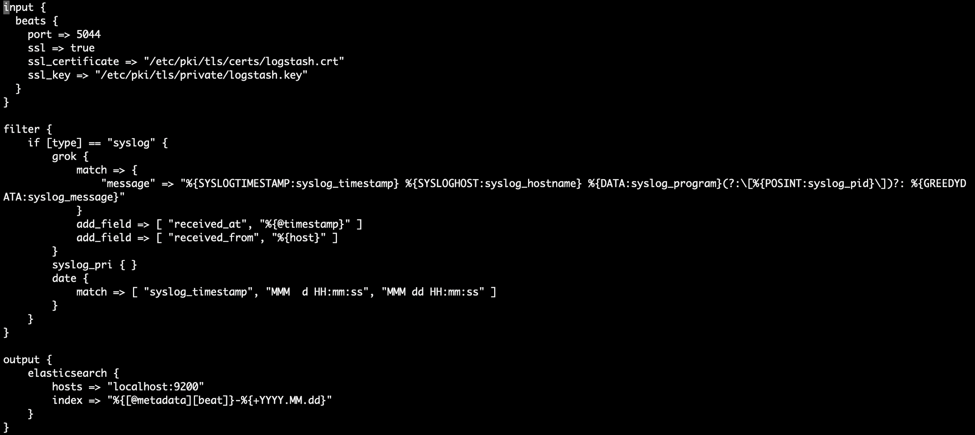
Sprint 2
Processing logs and sending them to ElasticSearch

Slide 4
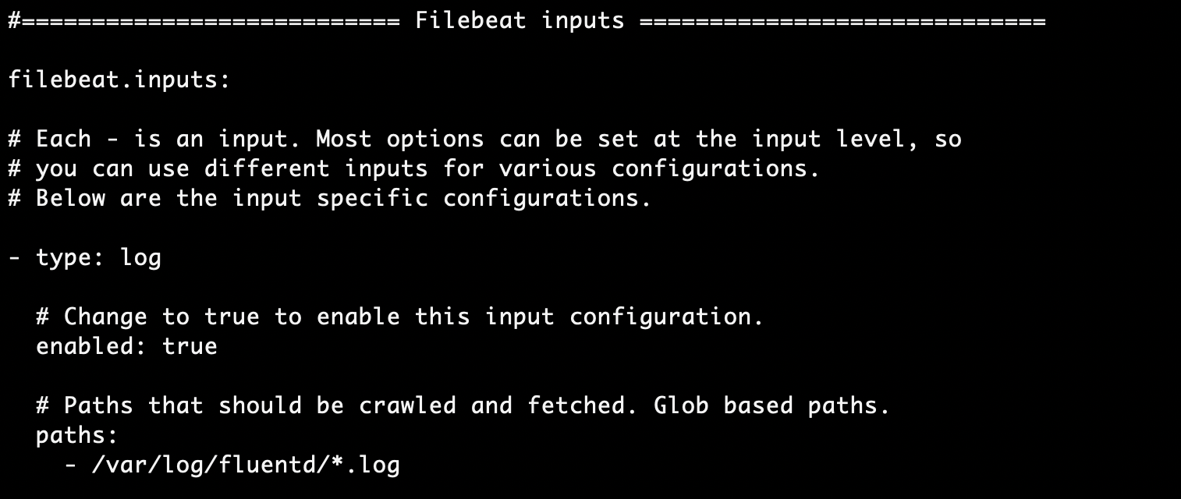
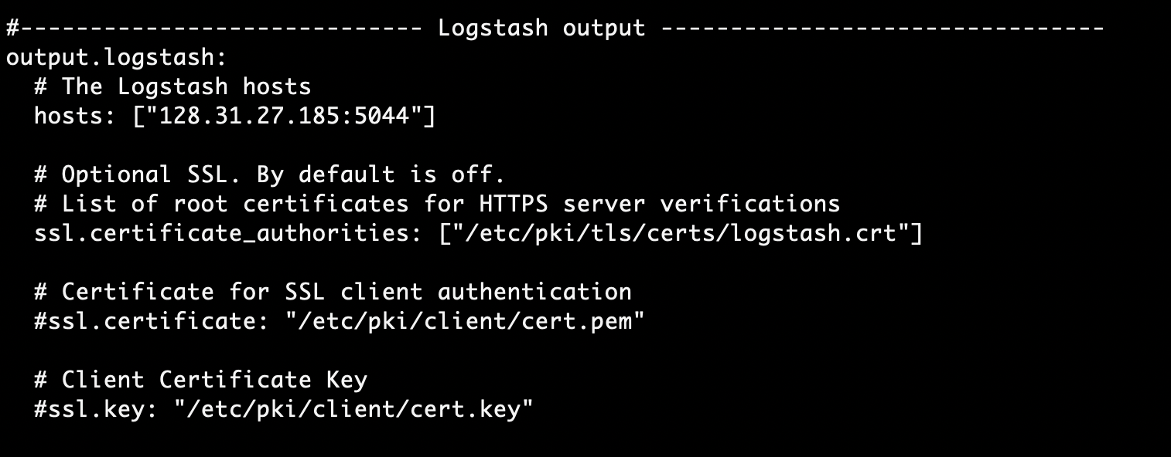
Sprint 2
2. Configuring filebeat to fetch logs from fluentd and getting access to client using SSL certificate

Slide 5
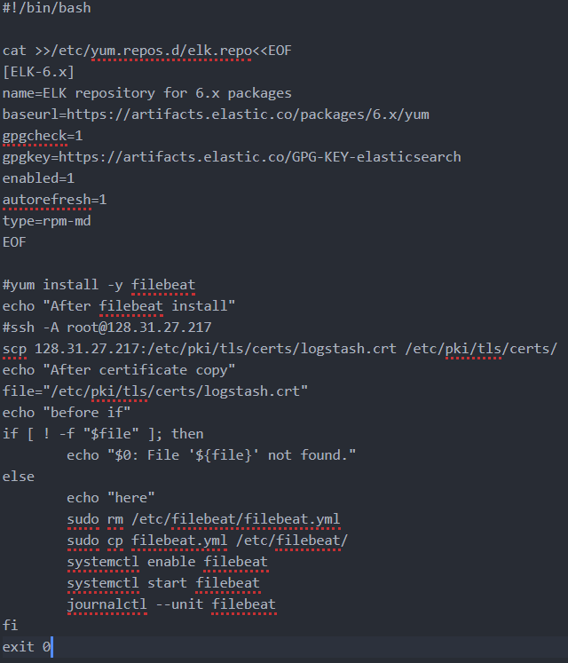
Sprint 2
3. Take files from one pod on elasticsearch and mapping it to Kibana

Slide 6

Burndown chart

